Slide 1

Can weather and mental health data provide predictive power in forecasting Incident Rate and Case Fatality Ratio of COVID-19?
By: Sophia Leeman, Isabella Wang, and Shatorupa Ghosh
Notes:
Photo credit: https://www.imf.org/en/Topics/imf-and-covid19/Policy-Responses-to-COVID-19

Slide 2



Background
Predicting COVID-19 severity in individuals is imperative to supporting at-home monitoring of symptoms and clinical decision-making
Interested in using digital health monitoring devices to make predictions of COVID-19 severity on the individual level
Previous literature linked heart rate variability to elevated COVID-19 symptoms
Hoping to uncover new determinants of symptom severity using a dataset collected from the Welltory app
Heart rate
Sleep patterns
Body temperature
Blood oxygen levels
Weather
Mental health
Notes:
How many people in this room have had covid?
How many people were treated in a hospital?
50% of americans had covid, but only 6 million hospitalized
https://www.hks.harvard.edu/faculty-research/policy-topics/health/half-us-population-has-had-covid-many-cases-are-going#:~:text=About%20half%20of%20American%20adults%20surveyed%20say%20they%20have%20been,positive%20for%20COVID%2D19%20before.
https://www.cdc.gov/coronavirus/2019-ncov/covid-data/covidview/index.html

Slide 3
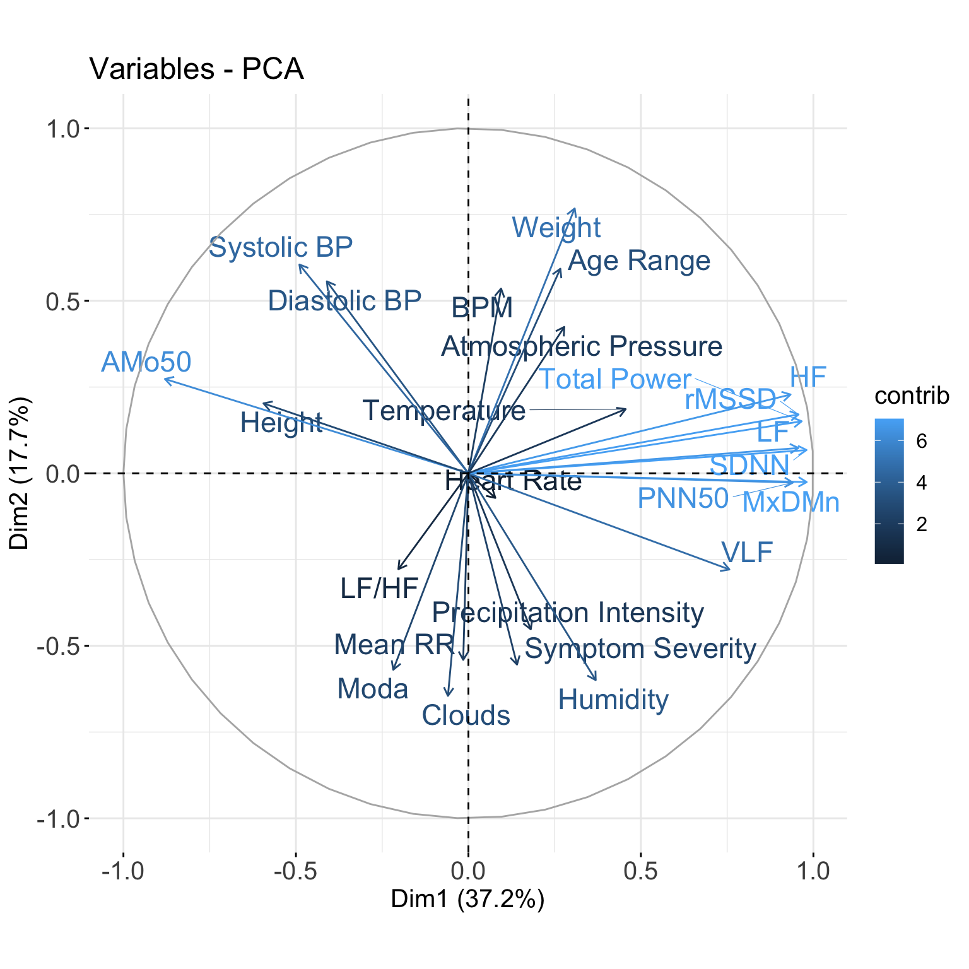
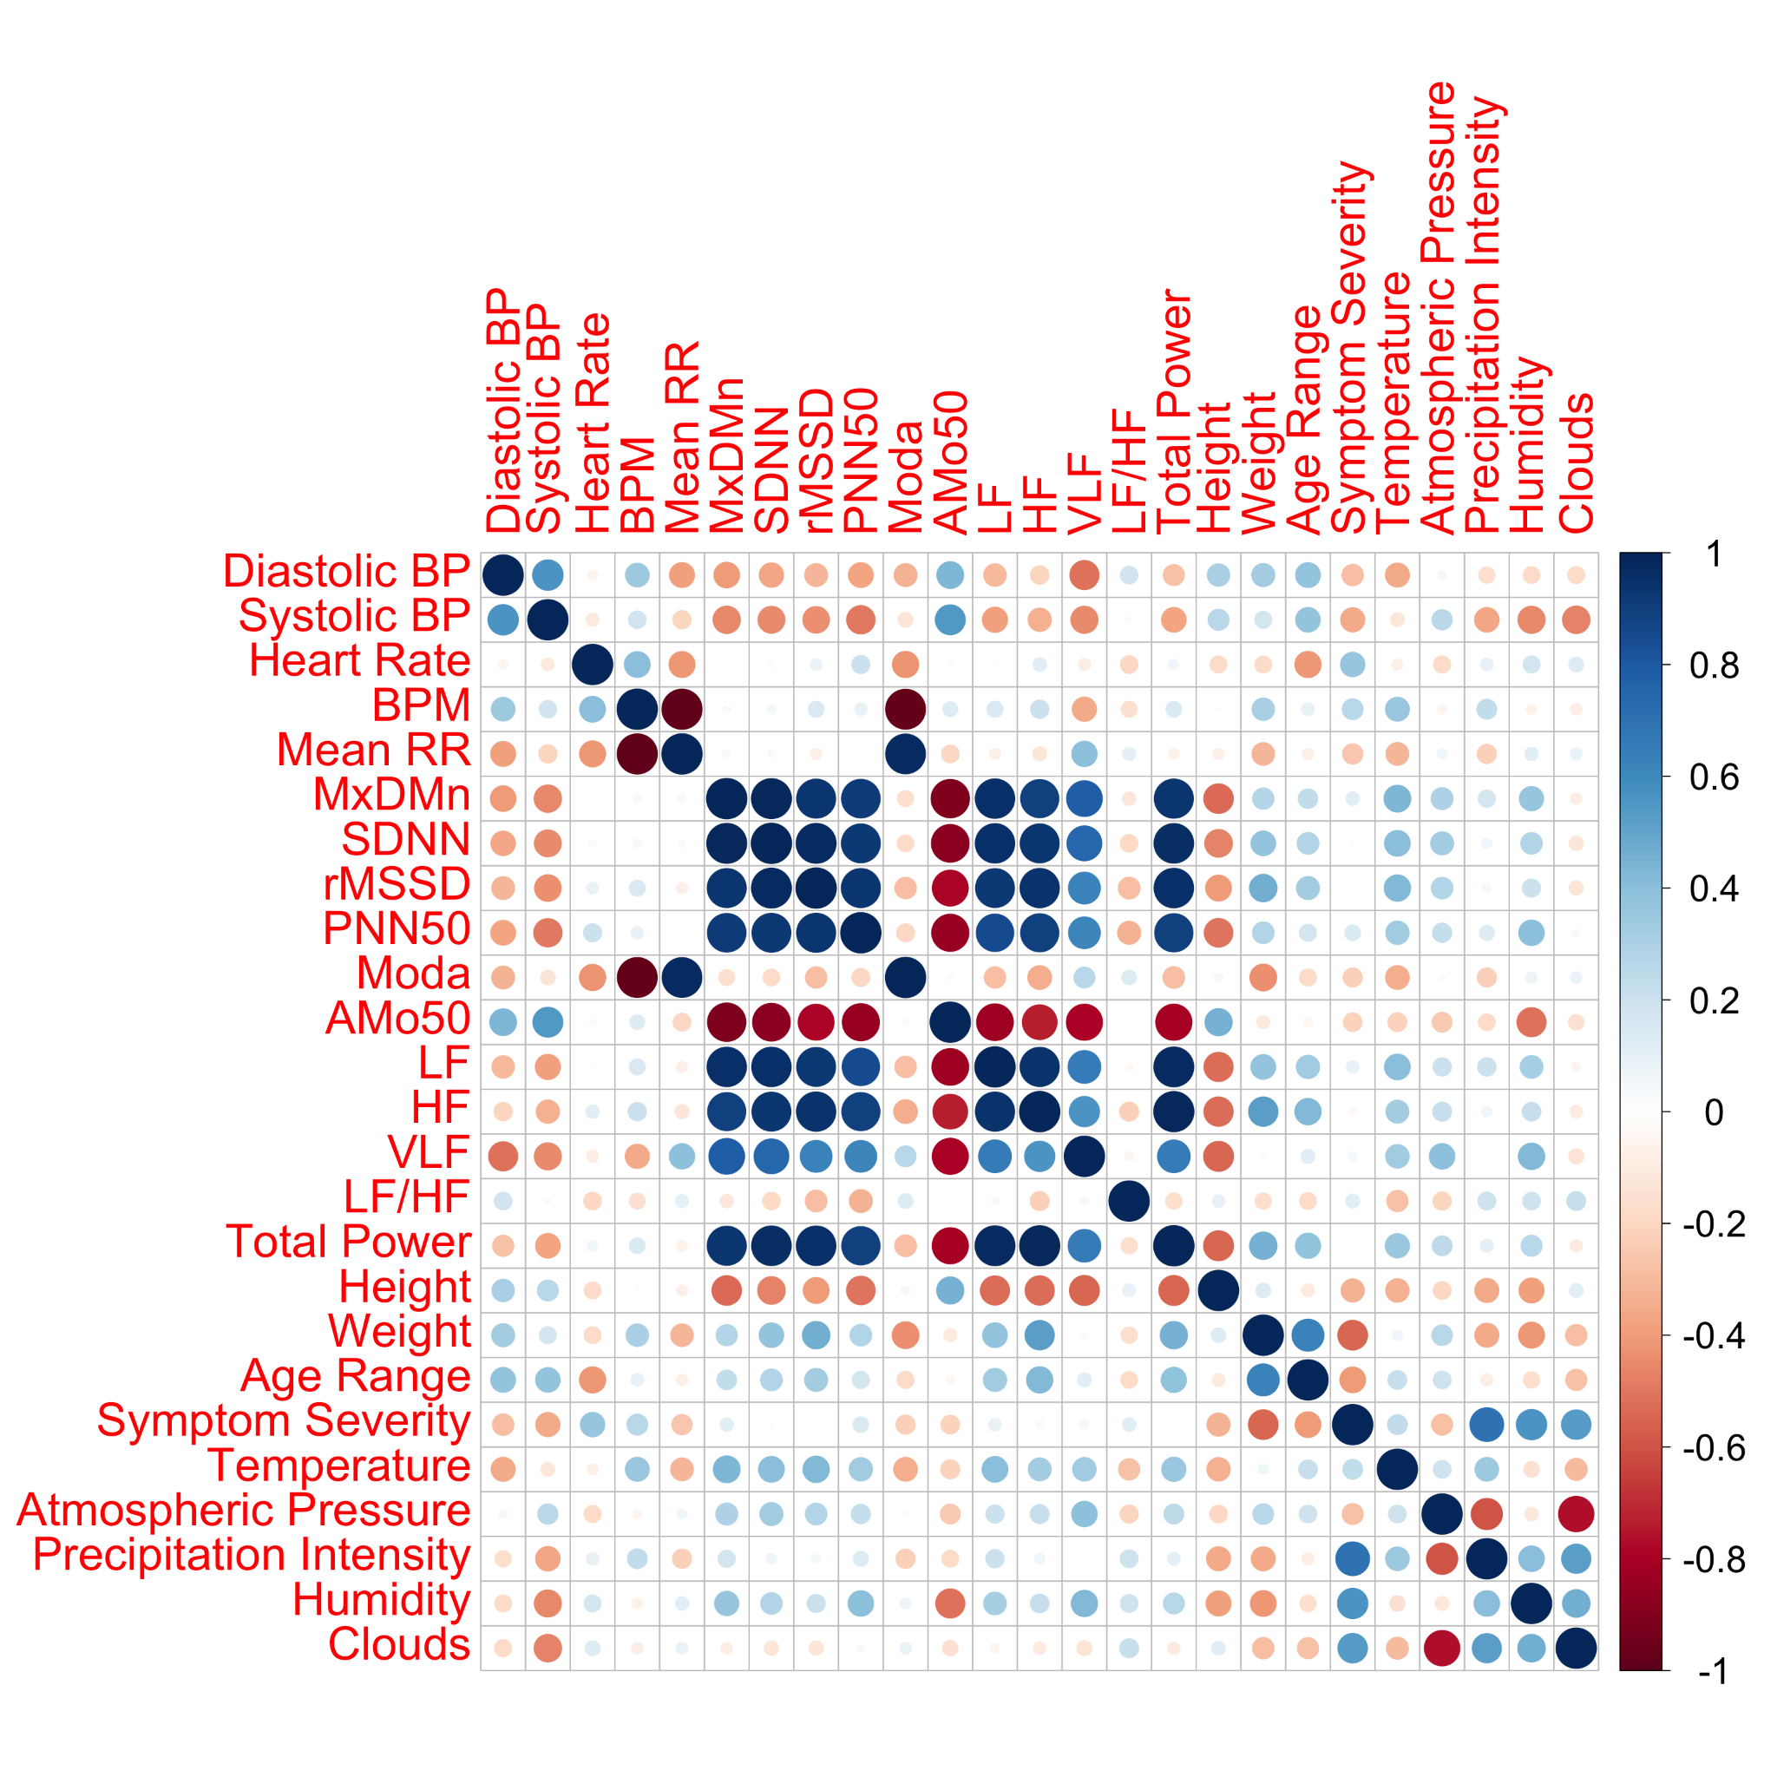
Preliminary Exploratory Data Analysis
Notes:
Exploratory Data Analysis (EDA) results supported the findings from previous literature that fluctuations in heart rate variability are important
However, the EDA also showed a new relationship between weather and the experience of COVID-19 symptoms
PCA was done after centering and scaling

Slide 4
Hypothesis: Weather and mental health data can be used to predict COVID-19 incidence and severity
Predicting the incidence rate and case fatality ratio of COVID-19 at the state level is extremely important to producing informed legislation that curbs its spread in the population and properly allocates resources
Scaled our problem up to investigate statewide weather and mental health trends in relation to measures of COVID-19 severity at the population level
Goals:
Develop two predictive models: one for Case Fatality Ratio and another for Incidence Rate of COVID-19
Gain insights into factors impacting the spread of COVID-19 or resilience in the population
We hope that these models might be used to inform legislative and clinical decision-making regarding COVID-19

Slide 5
Data Description

Slide 6
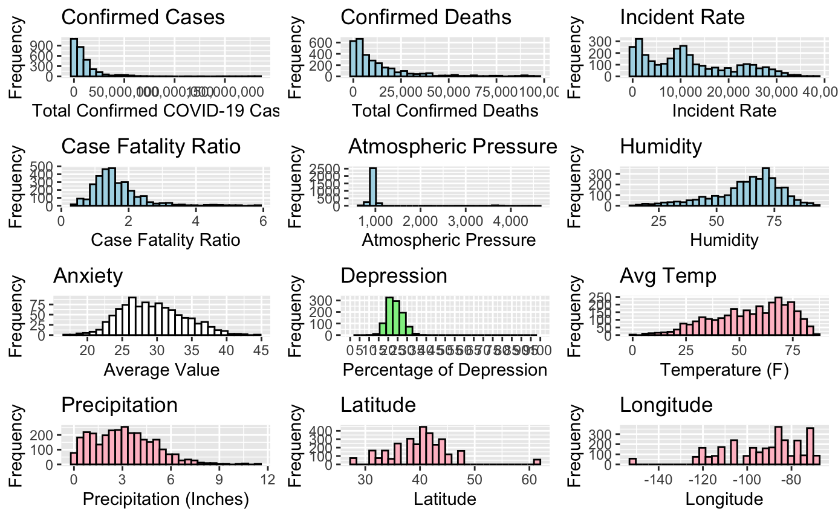
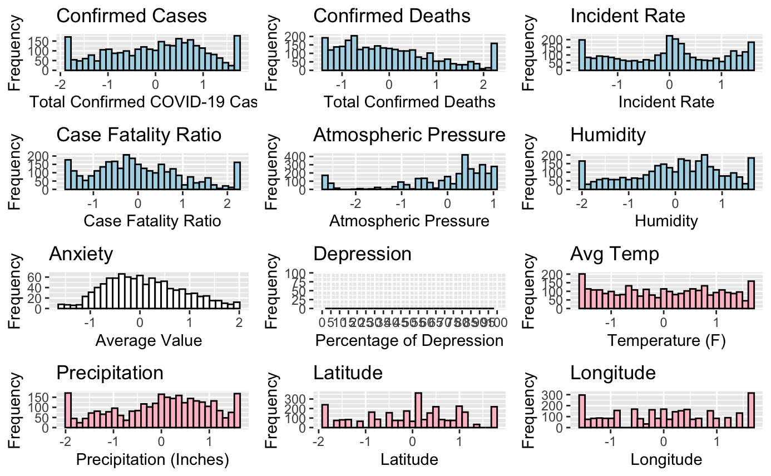
Data Preprocessing
Notes:
Centering, Scaling, Log and Square Root Transformations, Winsorization of outliers

Slide 7
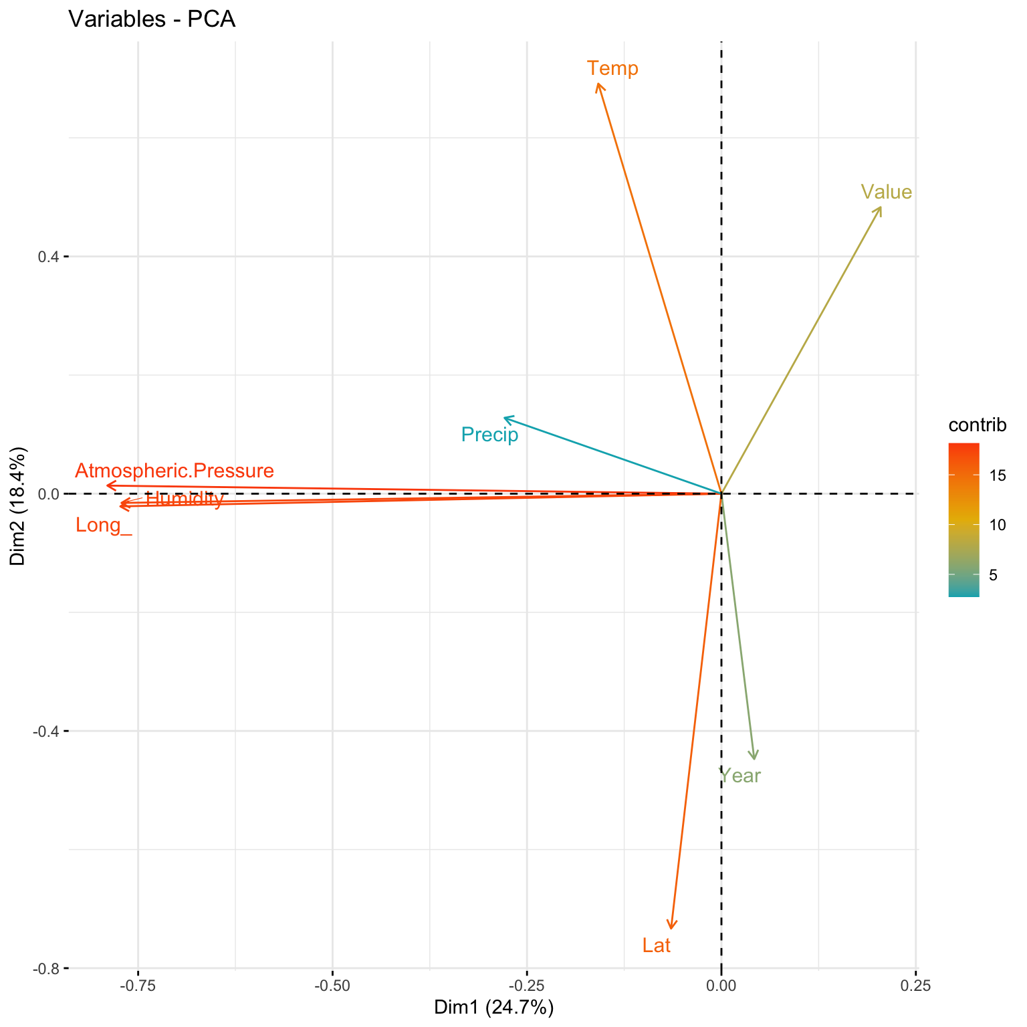
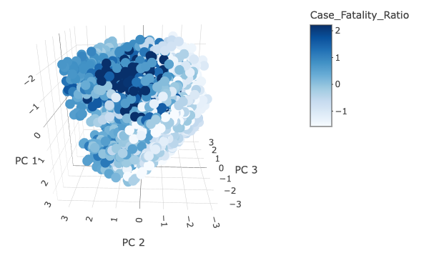
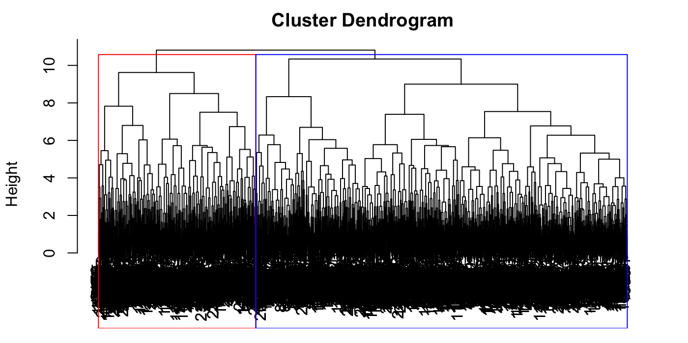
Exploratory Data Analysis - Case Fatality Ratio
Notes:
First 3 PCs were significant

Slide 8
Exploratory Data Analysis - Incident Rate

Slide 9
Predictive Model - Case Fatality Ratio

Slide 10
Predictive Model - Incident Rate

Slide 11
Limitations and Future Directions

